Slide 1

Healthcare Employee Attrition Report
Presenter Name : samuel Adekunle

Slide 2
BUSINESS QUESTION
What are the key drivers of employee attrition?
Which tenure group is at the highest risk of leaving?

Slide 3
ACTION
Salary Adjustments & Benefits: Offer competitive pay, bonuses, and benefits
Career Development: give room for more promotions and training

Slide 4
OBJECTIVE
Analyse employee attrition among different demographics, job roles, and departments.
Determining the most significant factors that influence employee attrition

Slide 5
SUMMARY
Nurse has the highest Attrition of 107 while Other has the highest Attrition rate of 16.3%
New Employees have the highest Attrition
The Maternity Department has the largest number of attrition
153 out of 199 attrition employees have a low Salary range
Total number of Employees 1,676
Total Attrition 199
Attrition rate 11.9%
Retained Employees 1,477

Slide 6
FACTS :
Attrition by Department
Maternity: 98 Employees
Cardiology: 74 Employees
Neurology: 27 Employees
Year at Company
New Employee: 124
Experience Employee: 68
Senior Employee: 5
Legacy: 1
Veteran Employee: 1
Attrition by Job Role
Nurse: 107 Employees
Other: 87 Employees
Therapist: 4 Employees
Administrative: 1 Employee

Slide 7
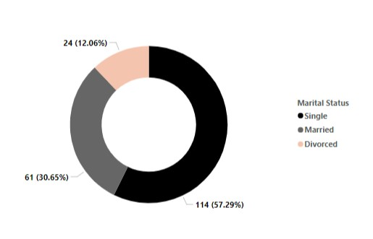
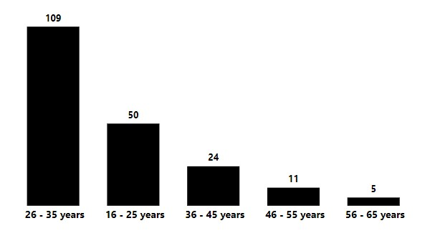
FACTS :
Younger employees are leaving at the highest rate
Marital Status
Age Range

Slide 8
INSIGHT
An attrition rate of 11.9% is generally considered good, as it falls within the typical range of the healthcare sector, which is often cited as between 10% and 18%.

Slide 9
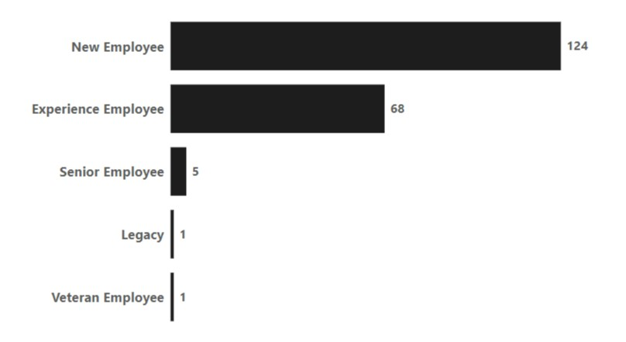
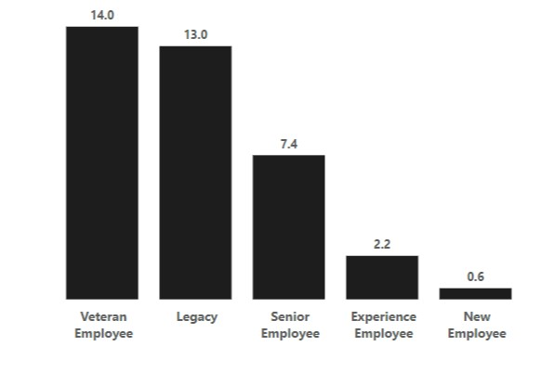
INSIGHT
New Employee has the lowest year of promotion,
Also has the highest Attrition rate.
Year at Company
Year of Promotion

Slide 10
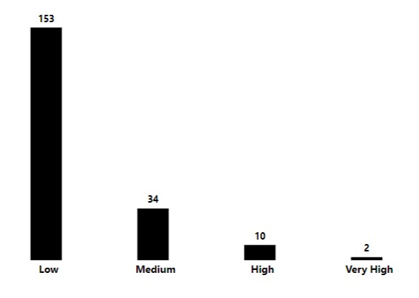
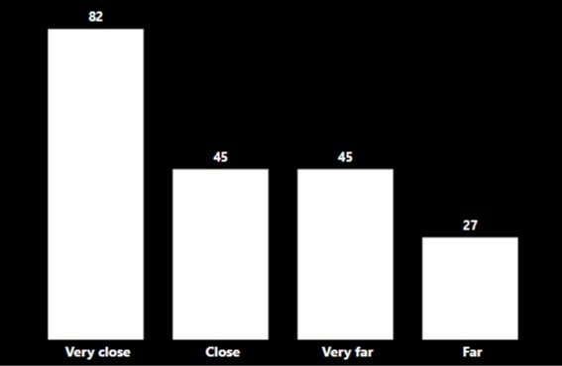
INSIGHT
Attrition came mainly from people who stayed within a short distance.
This suggests that distance is not the sole factor for attrition
77% of employees who leave the company earn low salaries which is a key factor in their attrition.
Monthly Income Range
Distance from Home

Slide 11
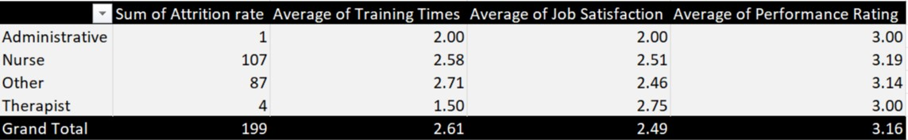
Job role | Job satisfaction | Performance rating | Training times
INSIGHT
Performance rating average of 3.2 which meets expectations.
An average job satisfaction score of 2.5 suggests that employees are neither fully satisfied nor completely dissatisfied but lean towards dissatisfaction.
An average training score of 2.6 on a scale of 1 to 6 implies that the training effectiveness and quality are below average; the training is not meeting expectations for most employees.

Slide 12
CONCLUSION
Promotion, Low job satisfaction, and salary are major drivers of attrition :
There is a negative strong relationship between attrition and years of promotion i.e. as one variable increases other variable decrease. There is a tendency for attrition to decrease as employees receive promotions over time.
Attrition will likely decrease as monthly salary increases, indicating a strong negative correlation.

Slide 13
RECOMENDATION
More training time should be given to the new employee
Frequent review of Monthly salary
Regular promotion, mainly for new employee

Slide 14
THANK YOU
Email adekunlesamuel701@gmail.com
Phone 09037074885

